Slide 1

Smart battery monitoring system
Presented By:
1. E1-80381 Satish Kumar
2.E1-80408 Ashish Bharadwaj
3. E1-80414 Poonam Devkar
4.E1- Ayisha Khan

Slide 2
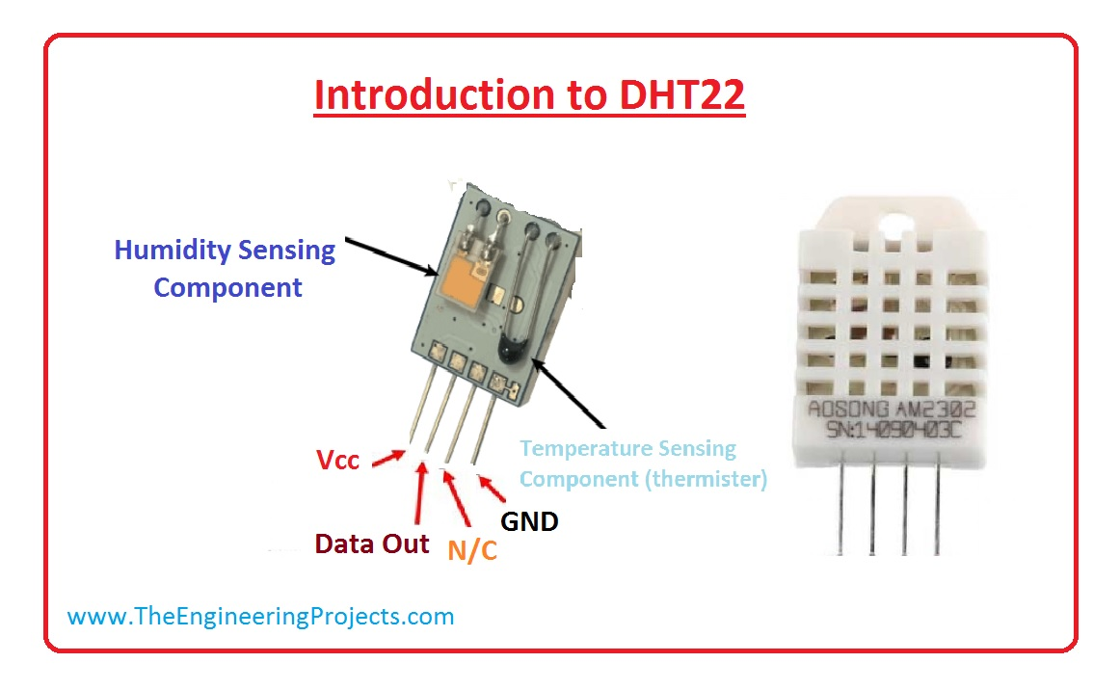

Slide 3
DHT22 Sensor
DHT22 –Digital Temperature sensor
AM2303 output calibrated digital signal. It utilizes exclusive digital-signal-collecting-technique and humidity sensing technology, assuring its reliability and stability. Its sensing elements is connected with 8-bit single-chip computer.
Small size & low consumption & long transmission distance (20m) enable AM2303 to be suited in all kinds of harsh application occasions.

Slide 4
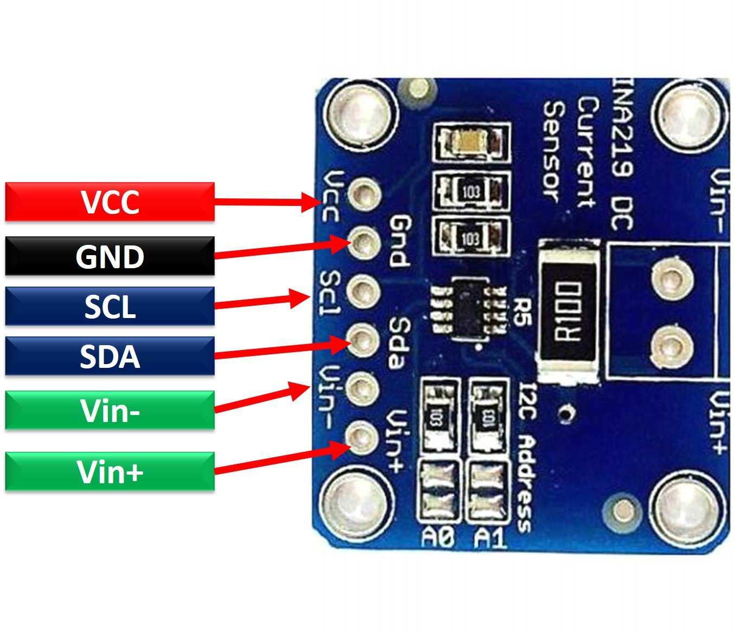
Current Sensor

Slide 5
INA219 Current Sensor
The INA219 is a current shunt and power monitor with an I2C- or SMBUS-compatible interface. The device monitors both shunt voltage drop and bus supply voltage, with programmable conversion times and filtering.
A programmable calibration value, combined with an internal multiplier, enables direct readouts of current in amperes.
An additional multiplying register calculates power in watts. The I2C- or SMBUS-compatible interface features 16 programmable addresses

Slide 6
Physical Connection
As the DHT22 works on single wire data bus, only one wire is required for data transmission. To supply power to the sensor 3V3 is provide to its power pin and ground is connected to discovery board ground. Connection are as follows.
Sensor F407 discovery board
VDD 3V
Data PD11(Port D pin 11)
GND Ground

Slide 7
Physical Connection
INA219 communicates over I2C hence it is attached to I2C1 peripheral of the discovery board. The PULLUP resistor for SDA and SCL are already mounted on the breakout board. Hence no need to connect PULLUP resistor. Again 3V3 is supplied to INA219. Connection are as follows.
Sensor F407 discovery board
VCC 3V
GND Ground
SDA PB7(Port B pin 7)
SCL PB6(Port B pin 6)
VIN+ and VIN- are the input pins thus connected in battery network.

Slide 8
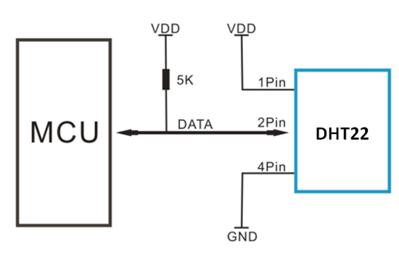
Communication protocol
DHT22 to STMF407 :
To read data from dht22 sensor first we have to provide a low level pulse for at least 18ms. After which the sensor provide 40 bits data on the same single wire.

Slide 9
Communication Protocol
INA219 to STMF407 :
INA219 works on either I2C or the SMBus protocol. I2C (Inter-Integrated Circuit), alternatively known as I2C or IIC, is a synchronous, multi-controller/multi-target (controller/target), packet switched, single- ended, serial communication bus invented in 1982 by Philips Semiconductors.
I2C uses only two bidirectional open-collector or open-drain lines: serial data line (SDA) and serial clock line (SCL), pulled up with resistors. Typical voltages used are +5 V or +3.3 V, although systems with other voltages are permitted.
The I2C reference design has a 7-bit address space, with a rarely used 10-bit extension.
We have used I2C protocol in Fast Mode.

Slide 10
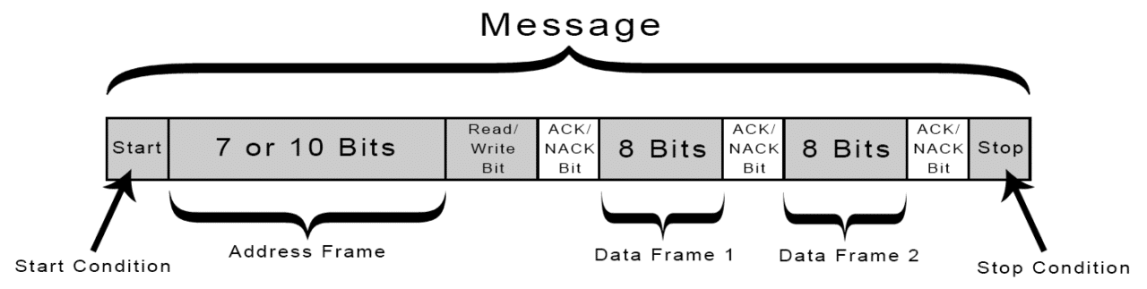
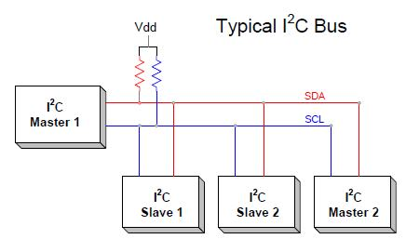
I2C Communication Protocol

Slide 11
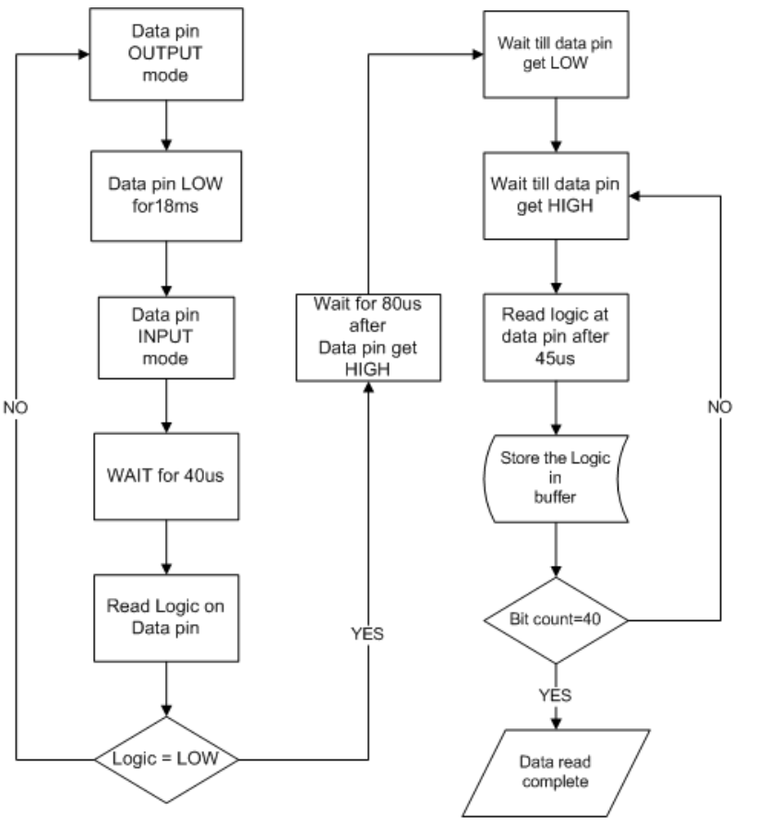
DHT22 data read sequence
Single-bus data is used for communication between STM32F407 and AM2303 (model name of DHT22), total time for one time data read is around 5ms. To save power DHT22 get into sleep mode after transmitting data.
To read data we have to wake up the sensor. This is done by pulling the data line LOW for at least 18ms by the MCU followed my releasing the data bus to HIGH. Sensor will take around 40us to process this wakeup call. Sensor will response by pulling data bus LOW for 80us the HIGH for 80us. This sequence is known as “Presence”, MCU will receive Presence only if the sensor is present on bus.
Falling this means that sensor is not present and we have to re-start the communication by send wakeup call again. After presence sensor send a 40 bit data which comprise of starting 16 bit of humidity data, next 16 bit of temperature data and an 8 bit CRC. After this sensor goes to sleep again.

Slide 12
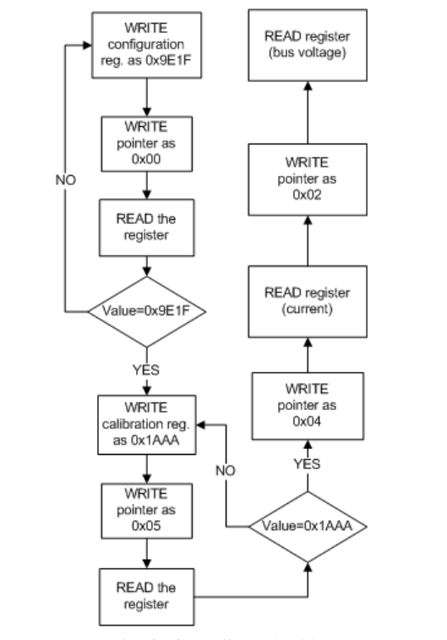
INA219 data read sequence
The MCU communicates with INA219 over I2C protocol in Fast mode i.e. 400kbps. I2C1 peripheral of STM32F407 is connected with sensor. STM32F407 is in master configuration and the sensor is slave.
To read data first, we have to configure then calibrate the sensor. We have to write the value in their respective register. To write data in register we have to specify the address of register also unlike reading register.
1. Setting the configuration register
2.Setting the calibration register

